Slide 1

Wireless HART
Compiled by:- Asst. Prof. Rashmi M. Pote

Slide 2
INTRODUCTION
HART Protocol:- “Highway Addressable Remote Transducer” is a hybrid analog+digital industrial automation open protocol.
Wireless HART is a Wireless Mesh Network Communications Protocol.
designed to meet the needs for process automation applications.

Slide 3
NETWORK ARCHITICTURE
Wireless HART Field Devices (WFD):
connected to the process or to plant equipment

Slide 4
NETWORK ARCHITICTURE
Wireless HART Gateways:
enable communication between Host Applications and WFD
support one or more Access Points
A Gateway and its Access Points must included in every Wireless HART network

Slide 5
NETWORK ARCHITICTURE
A Wireless HART Network Manager:
responsible for configuration of the network
scheduling communication between Wireless HART devices (e.g., configuring super frames)
management of the routing tables
monitoring and reporting the health of the Wireless HART Network

Slide 6
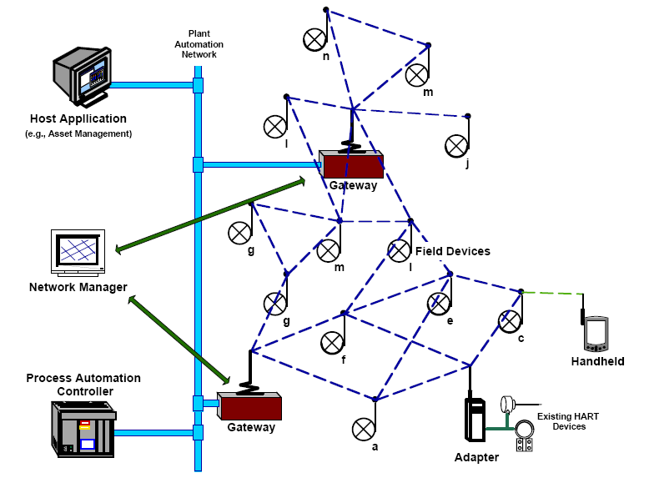
NETWORK ARCHITICTURE

Slide 7
LAYERS SPECIFICATIONS
Physical Layer:
Maximum data rate (250 kbps)
Operating Frequency (2.4 - 2.48 GHz)
transmit Power is 10dBm (Nominal) adjustable in discrete steps (e.g., 0dBM and others)

Slide 8
LAYERS SPECIFICATIONS
Data-Link Layer:
has long and short addresses
Additional Wireless HART DLPDU specifies a byte which identifies Wireless HART packet types
Bus Arbitration with TDMA using timeslots organized into super frames as 100 timeslots per second

Slide 9
LAYERS SPECIFICATIONS
Data-Link Layer:
Acknowledgement packets include timing information to continuously synchronize TDMA operation across entire network

Slide 10
LAYERS SPECIFICATIONS
Network Layer:
Upstream and downstream graph routing
Provides redundant path routing for maximum reliability and managed latency
Supports Broadcast, multi-cast and uni-cast transmissions.

Slide 11
LAYERS SPECIFICATIONS
Transport Layer:
provides un-acknowledged and end-end acknowledgement of communications
Acknowledged transmissions include automatic retries to confirm successful data transfer
also supports TCP-like reliable block transfers of large data sets

Slide 12
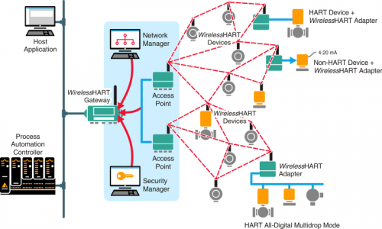
Example

Slide 13
Let’s watch a video
Simply explained: No-hassle wireless – with Wireless HART
https://www.youtube.com/watch?v=JGw9IRoj-Fs

Slide 14
CONCLUSION
Wireless HART provides new capabilities for users to get information on process parameters
The HART Communication Foundation provides worldwide support for application of HART technology

